Slide 1
E-commerce store
Tool used – Pandas , numpy & matplotlib
Team member name : Sonali Nimje
Mukul sheware
Sakshi ukey
Guided by : rashmi joshi mam
Company name : zappkode solution

Slide 2
Introduction
E-commerce, Or Electronic Commerce, Refers To The Buying And Selling Of Goods And Services Over The Internet. It Involves Online Transactions Where Businesses And Consumers Engage In Various Forms Of Commercial Activities Through Digital Platforms.

Slide 3
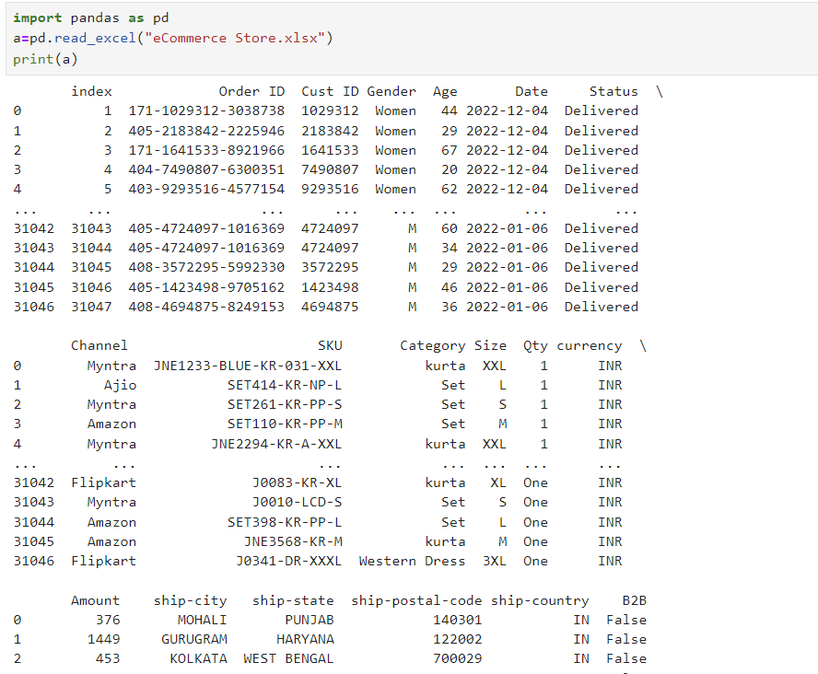
Show Data-

Slide 4
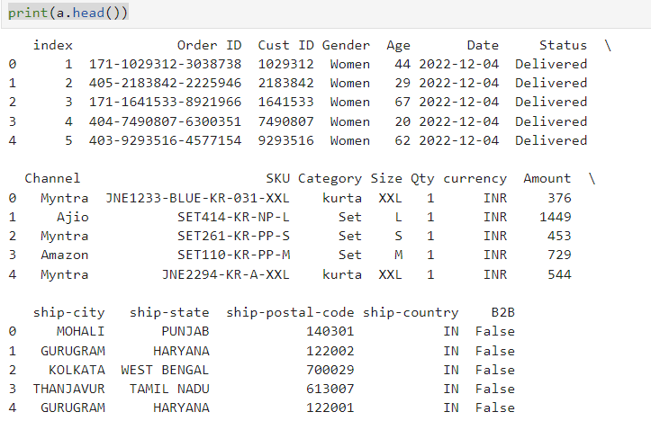
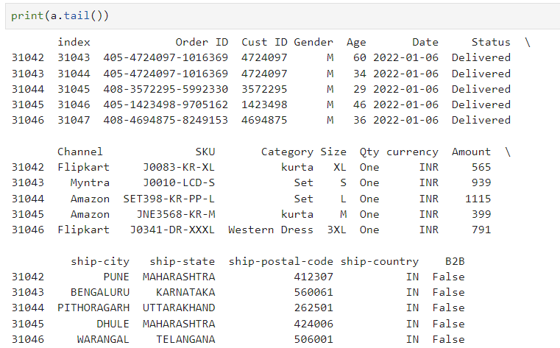
Show Head And Tail-

Slide 5
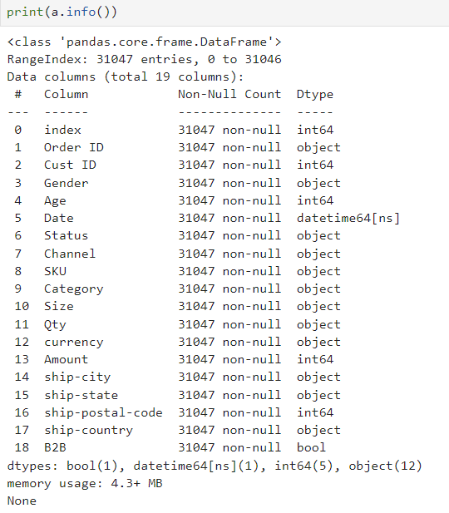
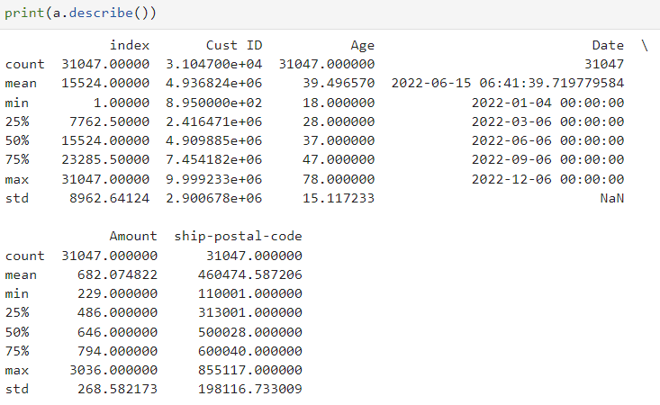
Show Info And Describe-

Slide 6
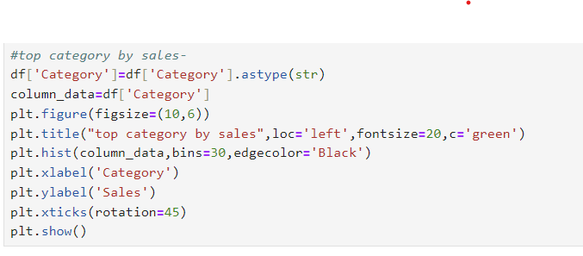
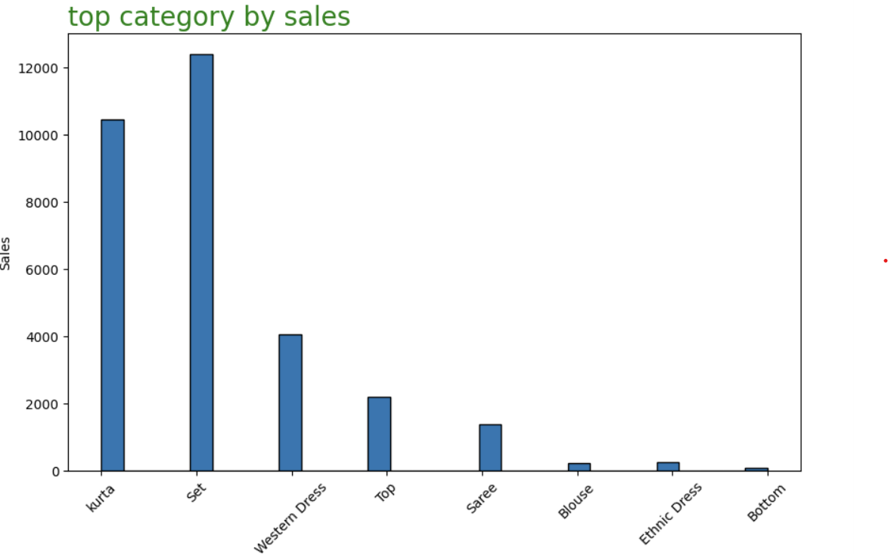
Top Category By Sales-

Slide 7
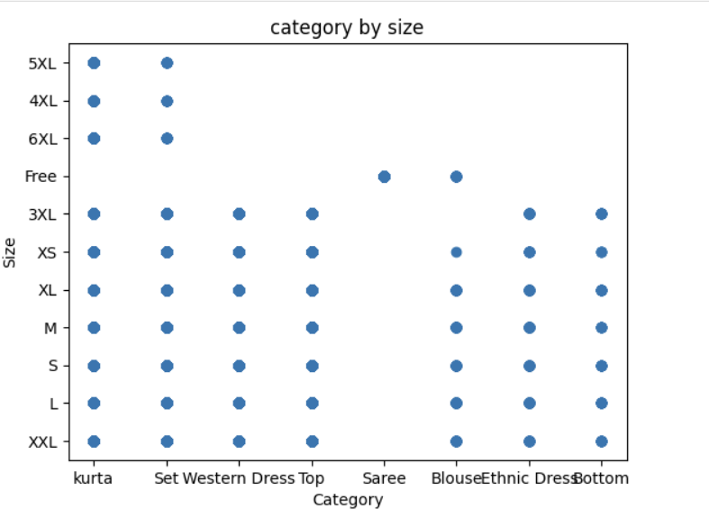
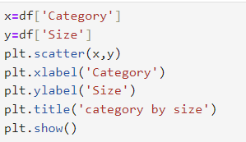
Category By Size-

Slide 8
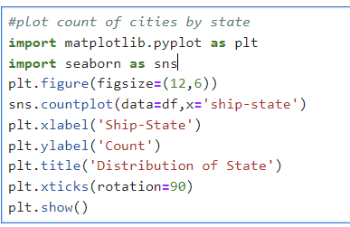
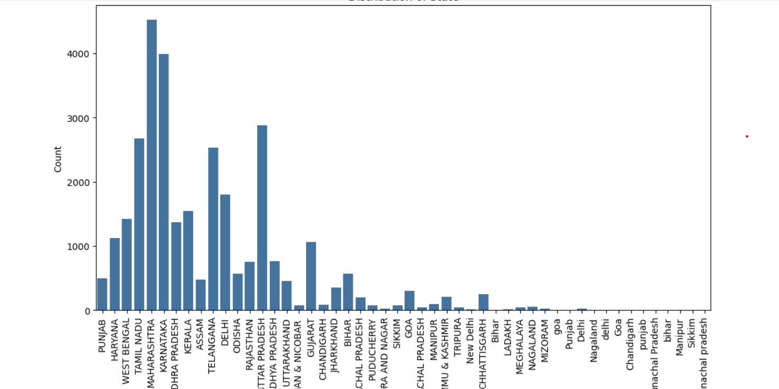
Distribution Of State-

Slide 9
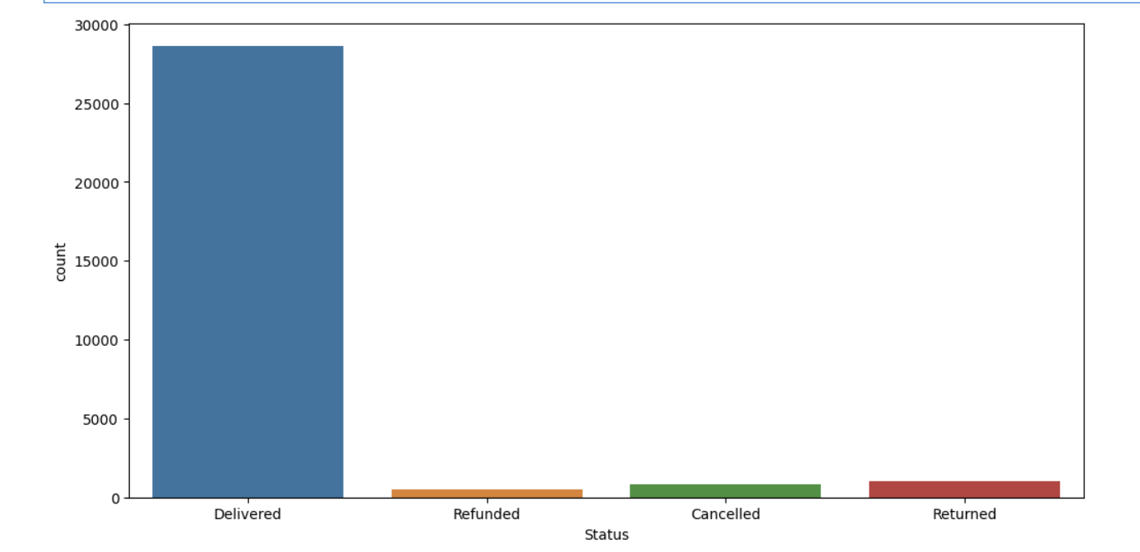
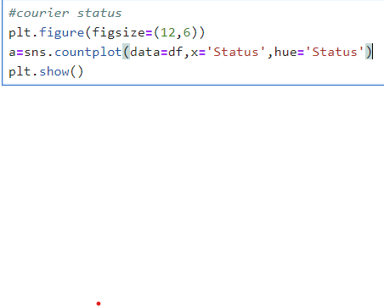
Find Courier Status-

Slide 10
Conclusion
E-commerce Has Transformed The Way Businesses Operate And How Consumers Shop, Offering Unparalleled Convenience, Access, And Choice. It Continues To Grow And Evolve With Technological Advancements And Changing Consumer Behaviors.
Thank you

